Slide 1
AskMyData
Query Your Data in Plain English
A Human-in-the-Loop Platform for RAG-Grounded, Semantically-Enriched Natural Language to SQL Generation
Name: Md. Tamim Hasan Toha
Roll: BSSE-1424
Supervisor: Dr. Emon Kumar Dey
Institute of Information Technology, University of Dhaka

Slide 2




AskMyData
2
The Problem
LLMs generate syntactically valid but semantically wrong SQL on real-world data
Ambiguous Column Names
Undocumented Relationships
Missing Business Context
What does "amt" mean?
Amount? Adjustment? Amortization?
LLMs can only guess.
No foreign keys defined.
LLMs infer joins incorrectly
and produce wrong results.
Domain rules, definitions, and
constraints exist only in people's
heads, not in the data.
WARNING: Existing NL2SQL tools skip semantic grounding entirely

Slide 3
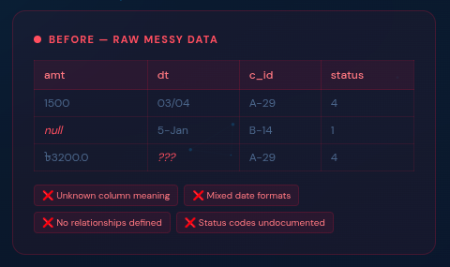
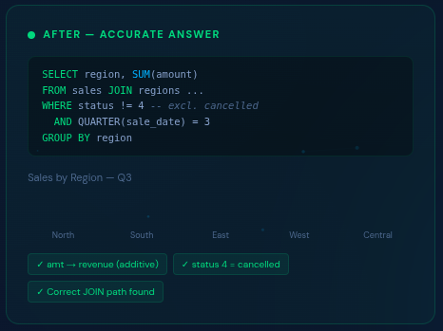

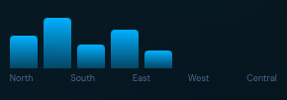
AskMyData
3
The Solution
AskMyData builds a semantic enrichment layer of the data source before NL2SQL generation
Total sales by region for Q3?

Slide 4
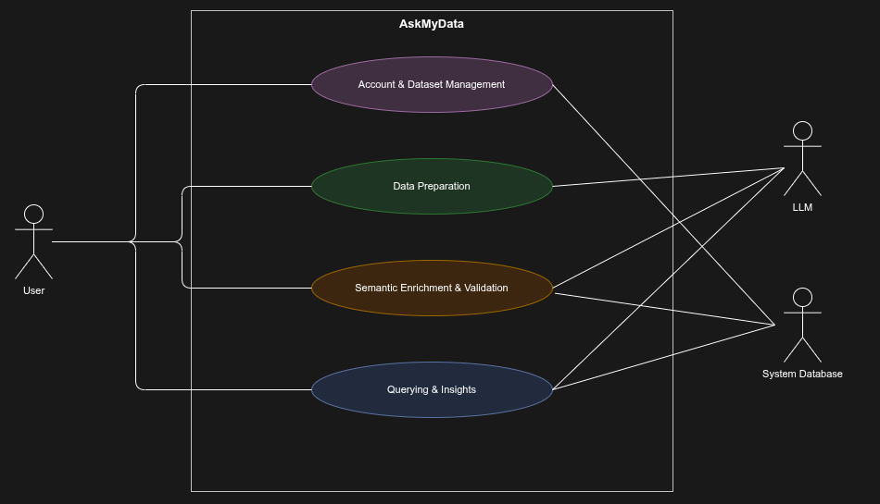
AskMyData
4
Usee Case Diagram

Slide 5
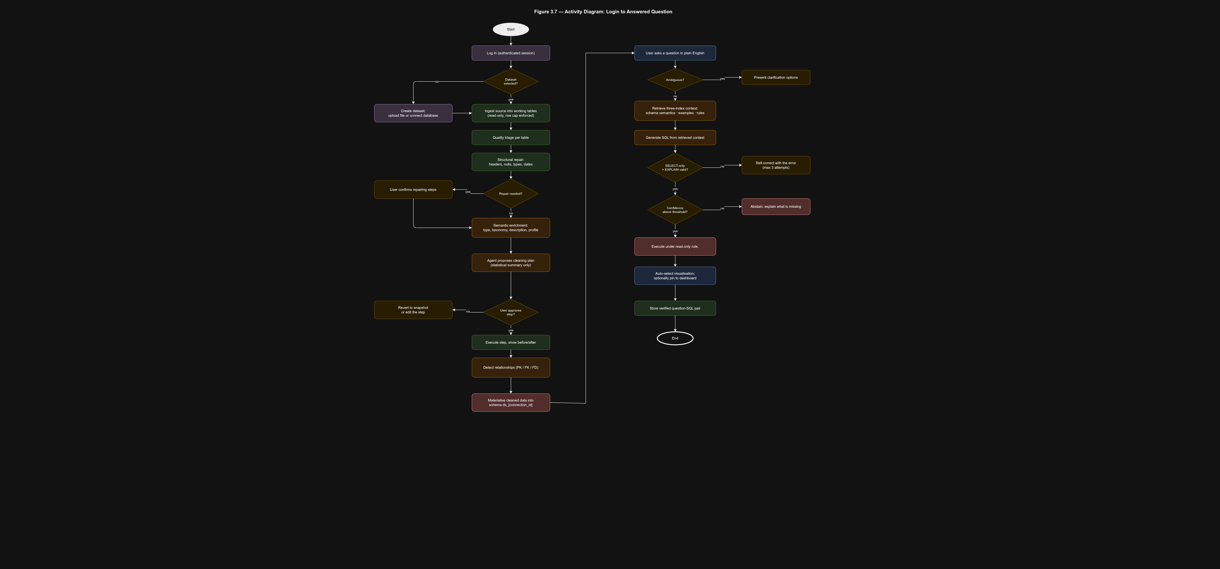
AskMyData
5
Activity Diagram

Slide 6
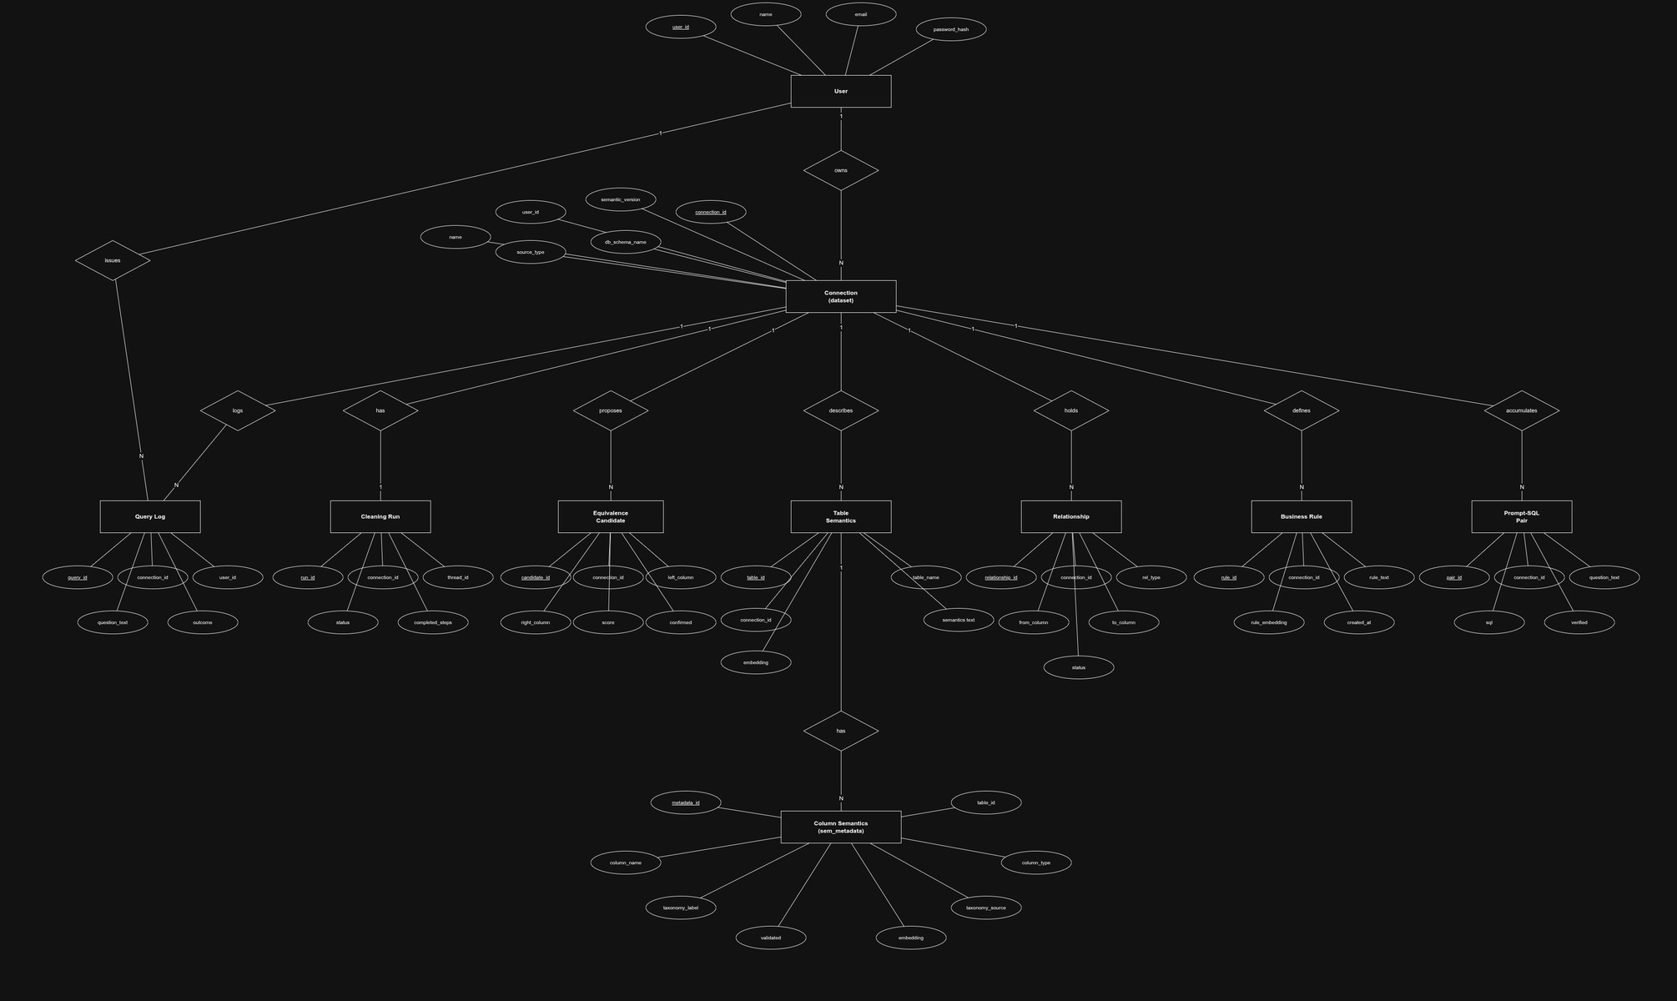
AskMyData
6
ER Diagram

Slide 7
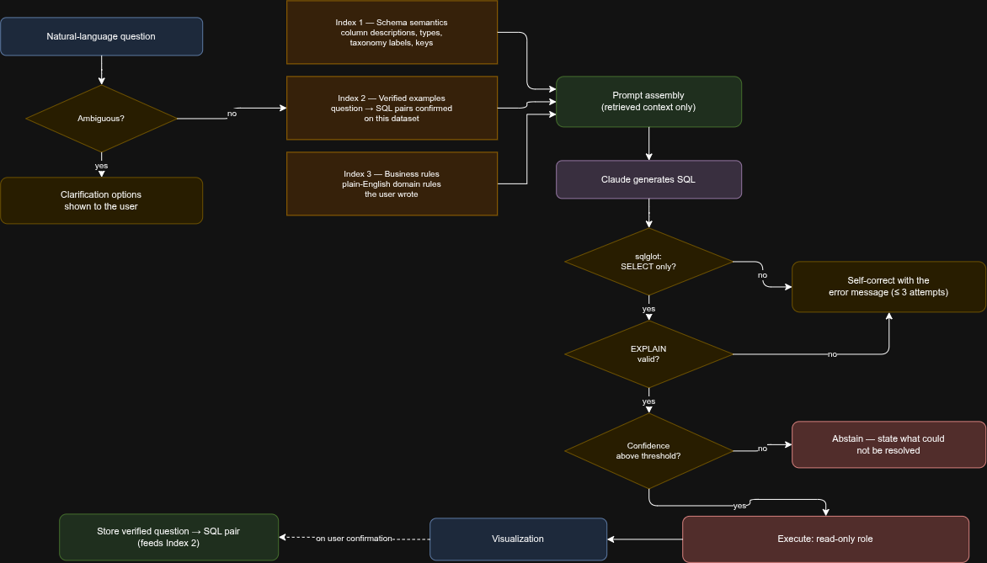
AskMyData
7
AI Pipeline

Slide 8
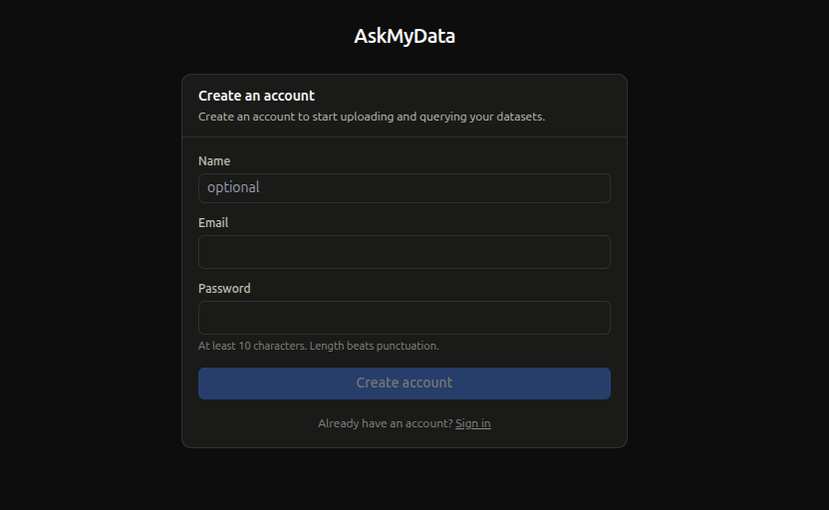
AskMyData
8
Sign Up

Slide 9
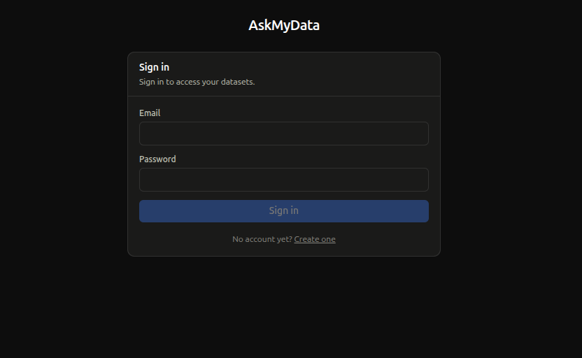
AskMyData
9
Sign In

Slide 10
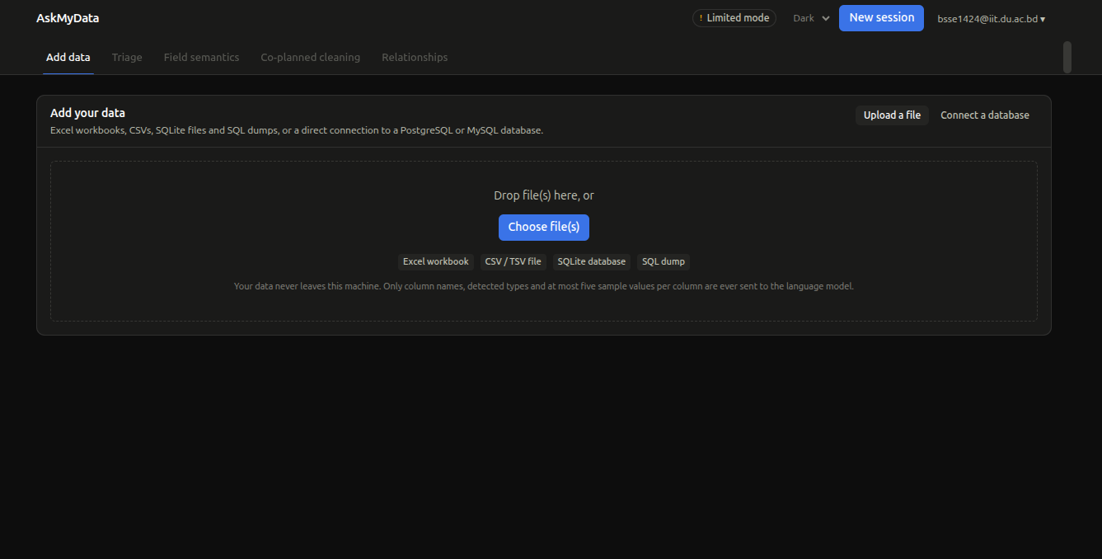
AskMyData
10
Add Data Source

Slide 11
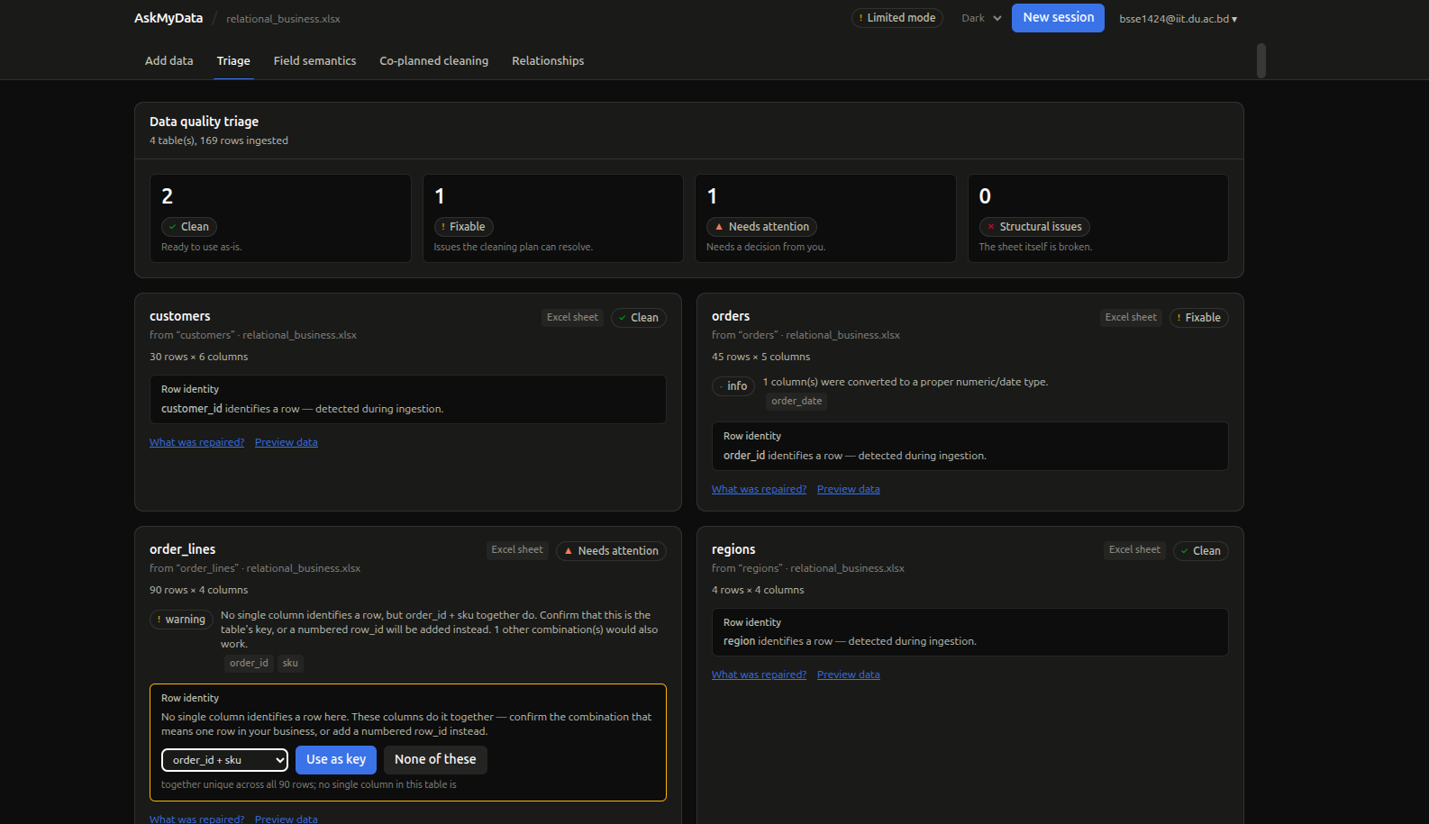
AskMyData
11
Triage Screen

Slide 12
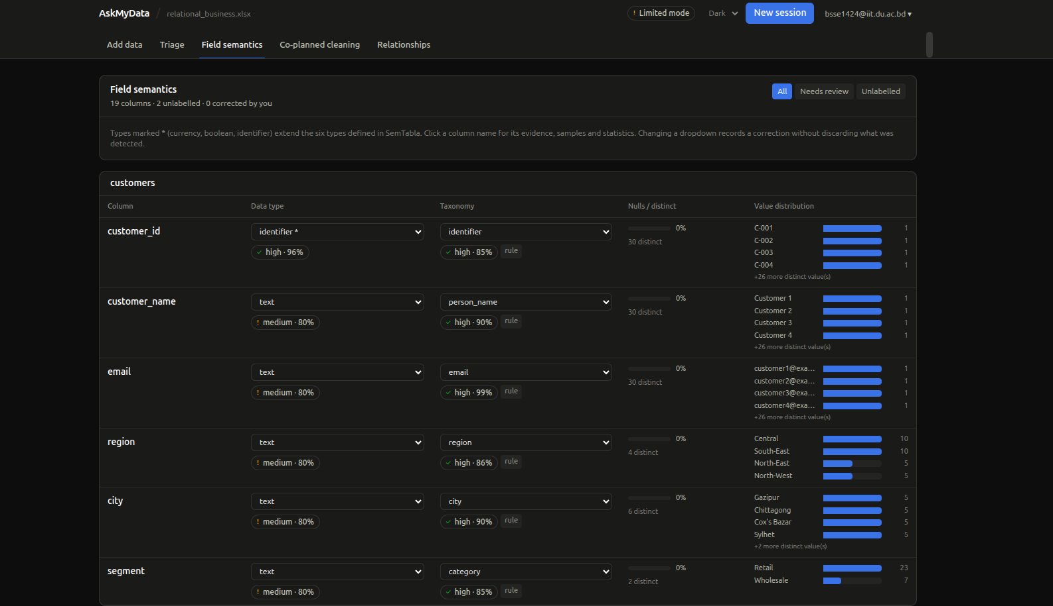
AskMyData
12
Field Semantics

Slide 13
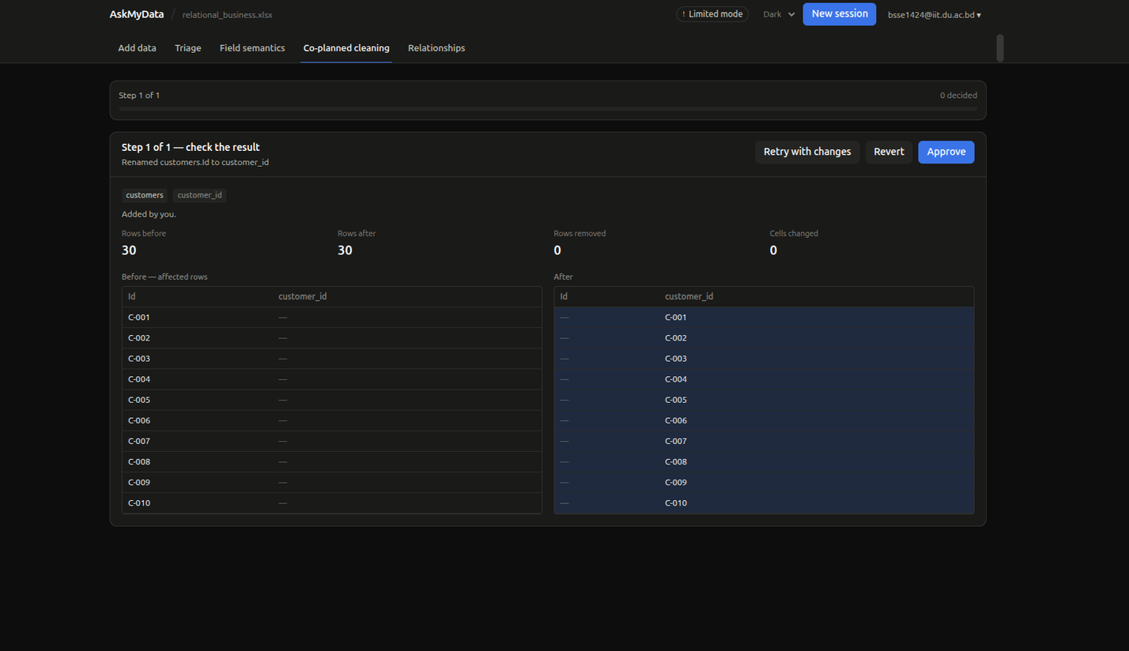
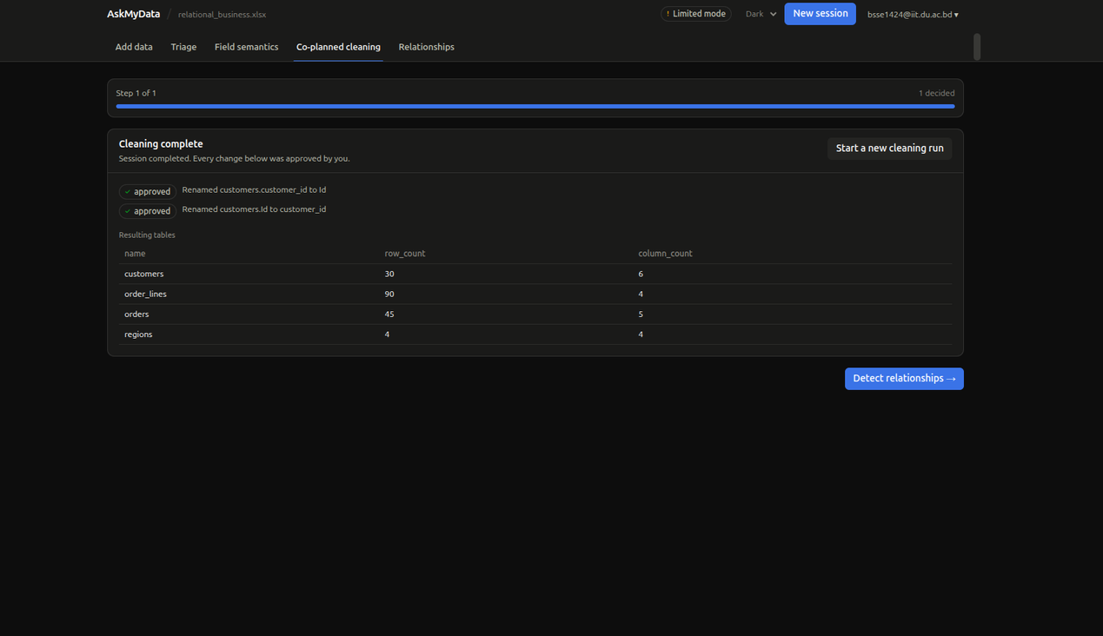
AskMyData
13
Co-planned Cleaning

Slide 14
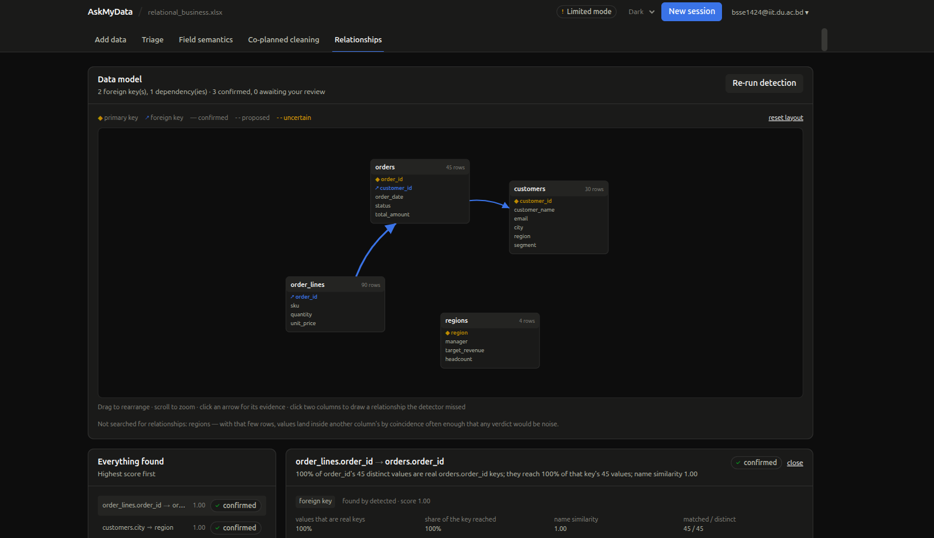
AskMyData
14
Relationships

Slide 15
Thank You
Questions and feedback are welcome
Email: bsse1424@iit.du.ac.bd | GitHub: https://github.com/T-T0ha/AskMyData | IIT, University of Dhaka

